Slide 1

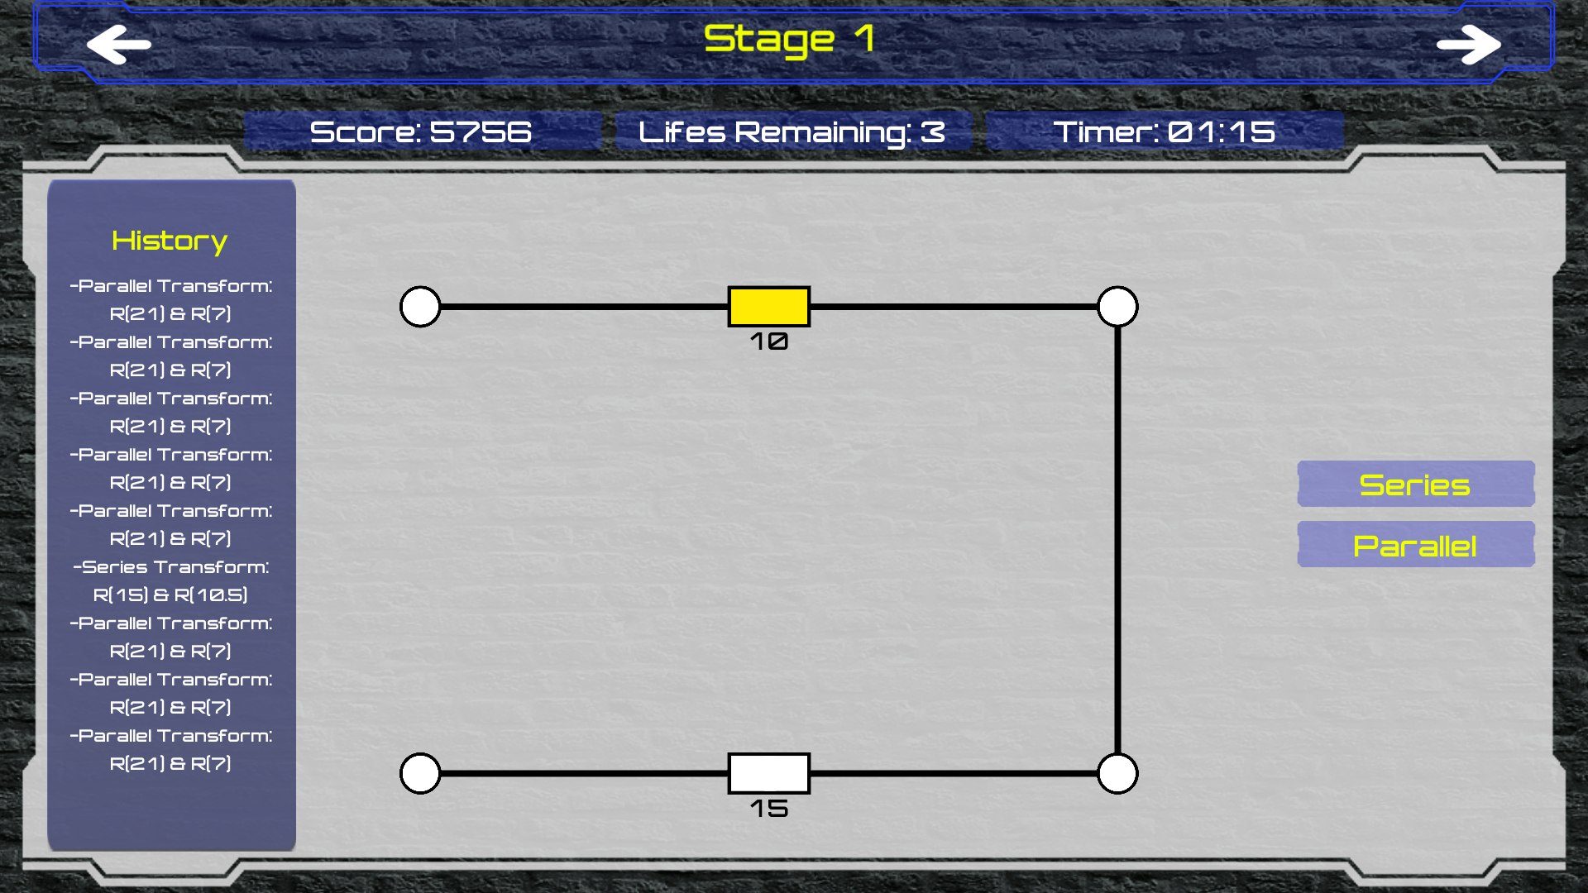

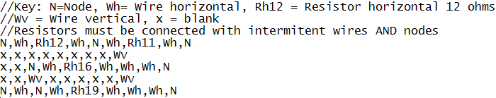
Educational Simulator of Electric Circuits Using Game Engines
Introduction
Analysis of electric circuits using different circuit theory methods is a challenging task to perceive by many students in electrical and computer engineering. This simulator will pave the way to develop a software that will visually imitate the working condition of electric circuits. A suitable game engine will be selected to build the simulator. Game engine will provide a visually attractive objects that can be interesting to learners.
Figure 2 – Level 1 Design
The Design
Conclusions and Future Work
Analysis of electric circuits using different circuit theory methods is a challenging task to perceive by many students in electrical and computer engineering. This simulator will pave the way to develop a software that will visually imitate the working condition of electric circuits. A suitable game engine will be selected to build the simulator. Game engine will provide a visually attractive objects that can be interesting to learners.
Text Based Circuit
Analysis of electric circuits using different circuit theory methods is a challenging task to perceive by many students in electrical and computer engineering. This simulator will pave the way to develop a software that will visually imitate the working condition of electric circuits. A suitable game engine will be selected to build the simulator. Game engine will provide a visually attractive objects that can be interesting to learners.
Visual
Interpretation
SpiceSharp Circuit
Transform Validation
References
Sven Boulanger, SpiceSharp, (2018), GitHub repository, https://github.com/svenboulanger/SpiceSharp
Contact
Circuit Modification
Adil Bhayani: abha808@aucklanduni.ac.nz Supervisor: Dr. Waleed H. Abdulla

